Slide 1


Raspberry Pi
An Introduction

Slide 3
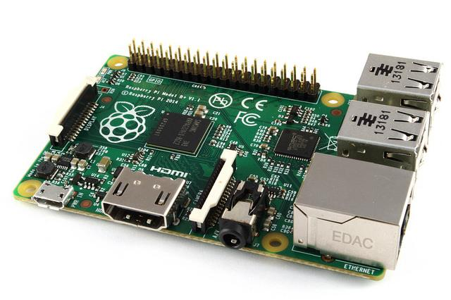
Introduction
The RPi is a tiny computer about the size of a credit-card, the board features a processor, RAM and typical hardware ports you find with most computers.

Slide 4
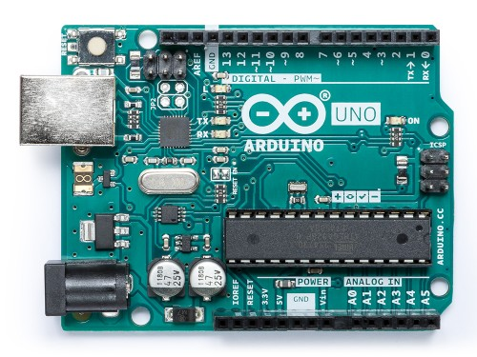
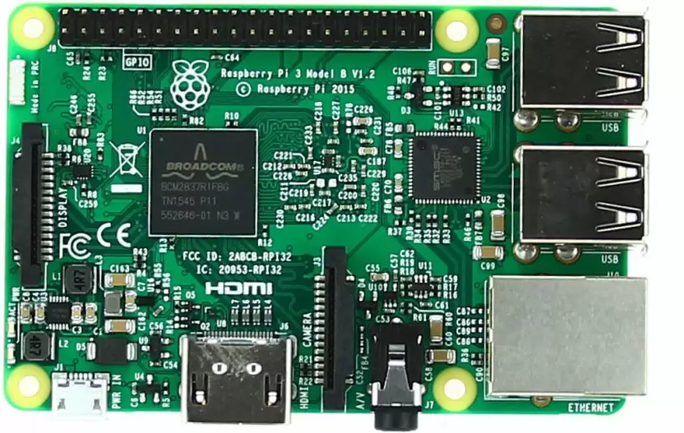
Difference between Raspberry Pi and Arduino

Slide 5
Raspberry Pi
The Raspberry Pi introduced in 2012, is a full-fleged computer which can do tasks like your desktop PC. From creating a web-server to making a gaming console for retro gaming, Raspberry Pi helps you to push your limits in coding and designing electronics circuits.
Arduino + Raspberry Pi
Not only they are useful individually, but together they can help you to implement all your ideas in mind to change the daily life. You can make any electronics design to make the routine it more convenient and easy with the help of Arduino IDE and Raspberry Pi model together.

Slide 6
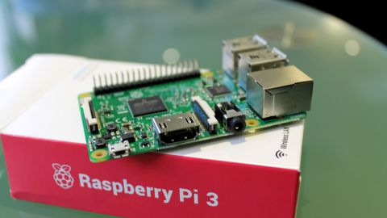
Parts of Raspberry Pi

Slide 7
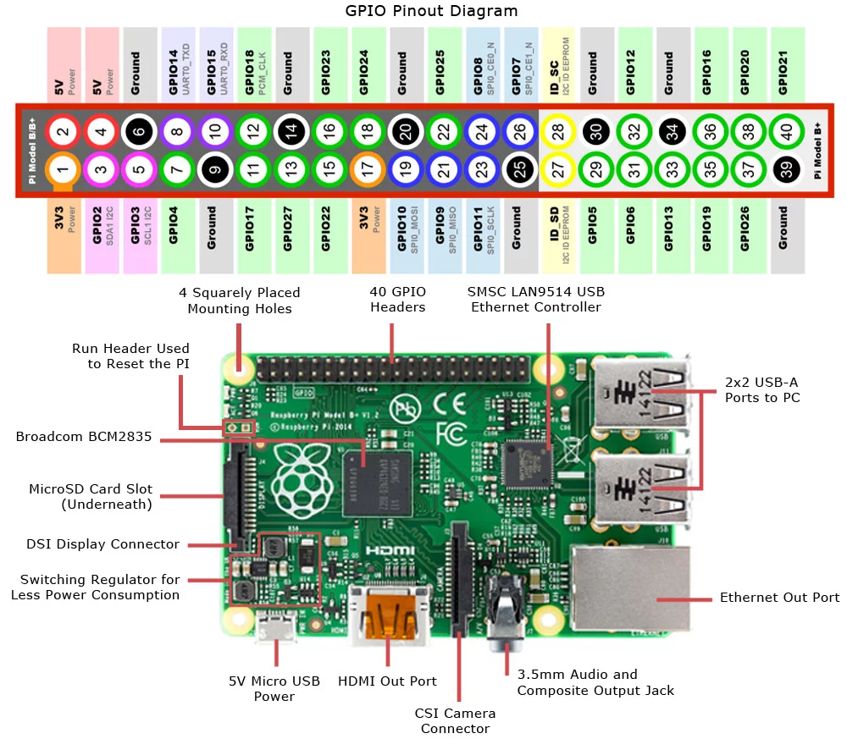

Slide 8
Advantages & Disadvantages of Raspberry Pi

Slide 9
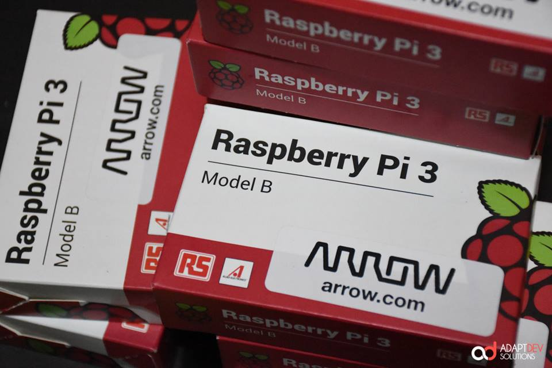
Advantages of Rpi
Lot of memory and processing capabilities. Expandable memory.
It is user friendly.
Lot of GPIOs available.
Built in Os Linux
P.L. : Python, C, C++, Ruby, Go and many more.
RPi used to run Open CV , data mining algorithms etc and connected the results to various applications.

Slide 10
Disadvantages of Rpi
Knowledge in Linux systems.
Closed source.
Power hungry.
The processing power will be an overkill processing-wise for most of the applications since we will use it only to send data across.

Slide 11
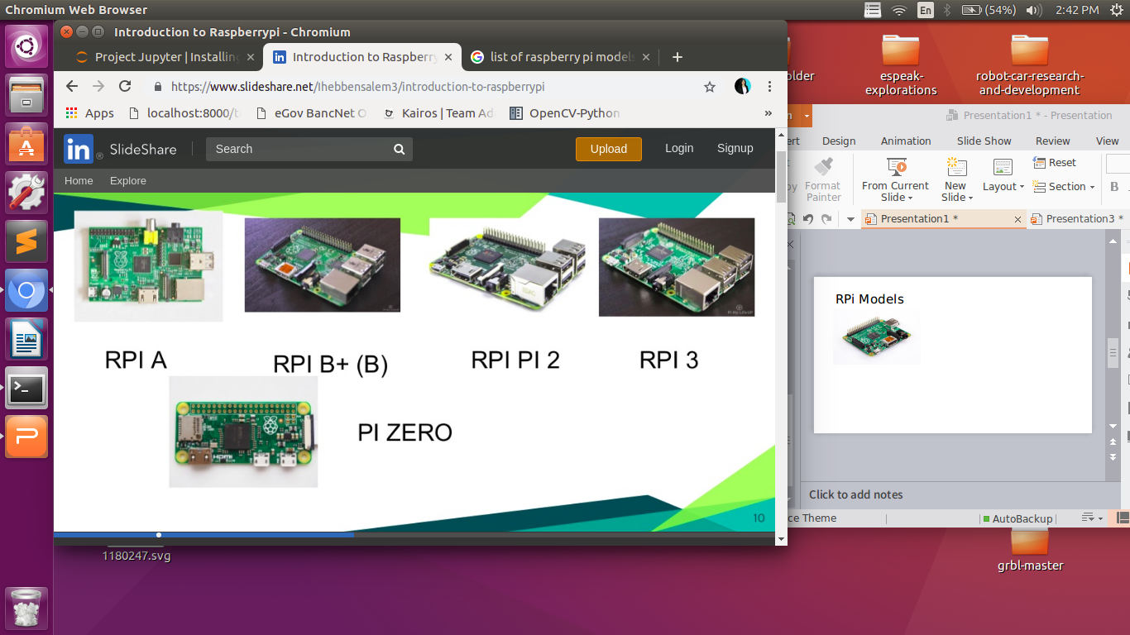
RPi Models

Slide 12
Access in Raspberry pi
- SSH (Secure Shell)
- IP Address
- Putty
- VNC

Slide 13
hANDLE WITH cARE
- The Raspberry Pi was built to be used, but not abused. Every P.CB. dhould be handled with care.
- Handle the Pi only by the edges of the board itself. Avoid tousching or holding any of the components on the board.
- Rough Handling can cause solder points to fail and may result in short circuits, but be careful with GPIO pins as well.
- While connecting Hardware. double check the connections and then power it up. Raspberry Pi GPIO's are not 5V tolerant.

Slide 14
How to setup Raspberry Pi card?

Slide 15
SD card | Minimum size 4gB (class 4)
HDMI to HDMI/ DVI | - HDMI to HDMI lead (for HD TVs and monitors). or - HDMI to DVI lead (for monitors with DVI input). Leads and adapters are available for few pounds - there is no need to buy expensive ones.
Power adapter | - A good quality, micro USB supply that can provide at least 700mA at 5V is essential. - Many mobile phone chargers are suitable - check the label on the plug. - If your supply provides less than 5V then your Raspberry Pi may not work at all.
Ethernet | RJ45

Slide 16
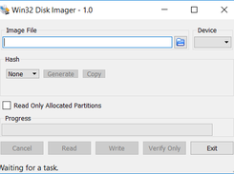
Preparing the SD card
1. Download RPI OS (Raspbian recommended).
2. Unzip the file that you just downloaded.
3. Download the Win32DiskImager software.
4. Writing Raspbian to the SDcard.
5. Booting your Raspberry Pi for the first time.
6. On first boot you will come to the Raspi-config window.
->Default username: pi
->Default password: raspberry

Slide 17
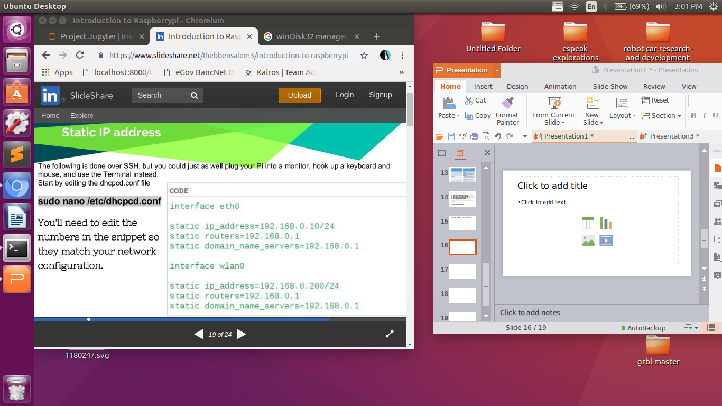
Static IP address and ssh config

Slide 18
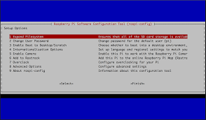
Enable ssh
Enter sudo raspi-config in the terminal, first select Interfacing options, then navigate to ssh, press Enter and select Enable or disable ssh server

Slide 19
Important Commands
1. ls
- “ls” command displays the file present in a givenn directory.
2. cd
“cd” or change directory command allows the user to traverse through the directories and file paths.
3. cp
- “cp” comman is used to copy file(s) from a source to a destination.
4. mv
- Move files from source to destination
5. rm
used to remove file/files.
6. mkdir
- used to make a new directory or folder in the current path.
7. rmdir
- used to remove a directory or folder in the current path.

Slide 20
8 clear
- used to clear the contents on the terminal window.
9. cat
- used to concentrate and output the contests of the given files.
10. pwd
- used to check the present working directory.
11. sudo
- allows users to run programs with the security priveleges of super user or root or adstrator.
11. chmod
- allows users to cahnge access modes onfiles.

Slide 21
Example projects using Raspberry pi

Slide 22
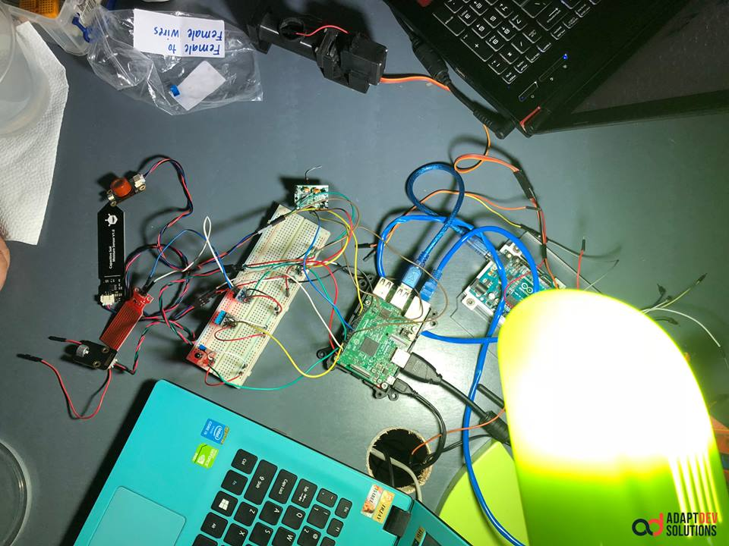
Sensor in Raspberry pi

Slide 23
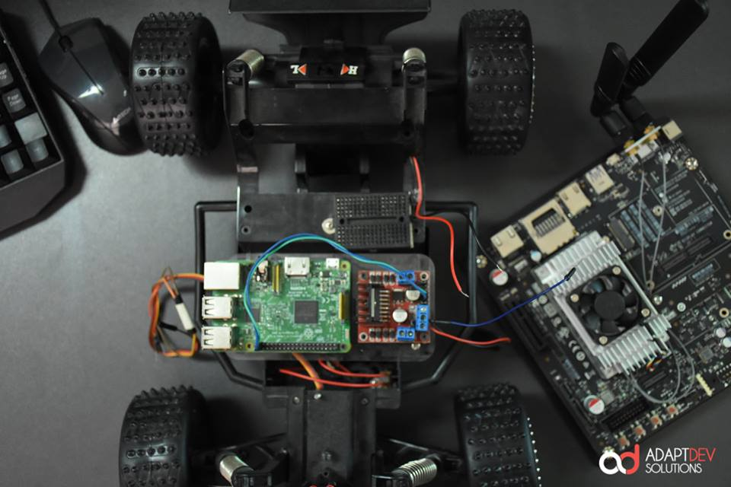
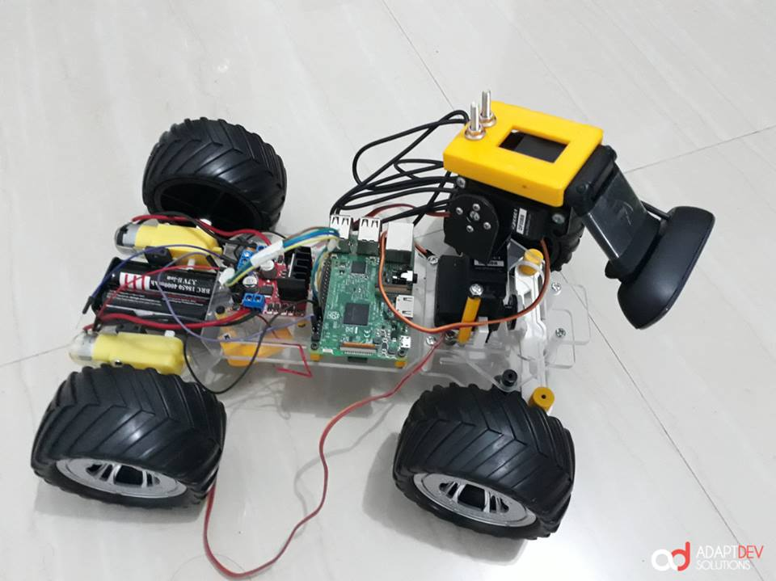
Robot car

Slide 24
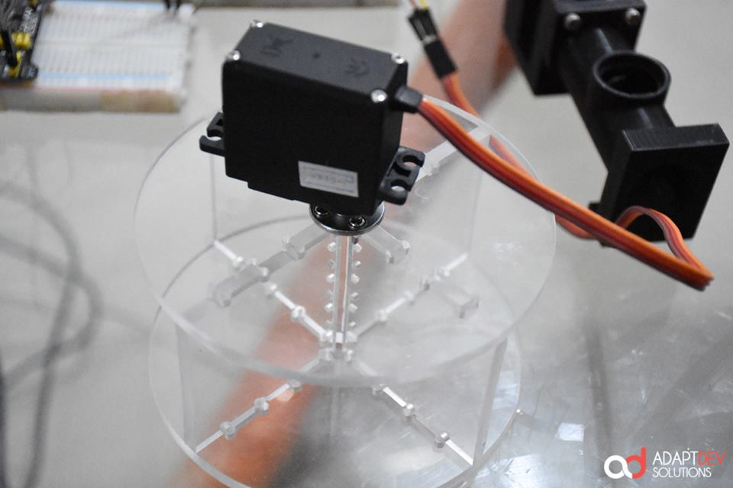
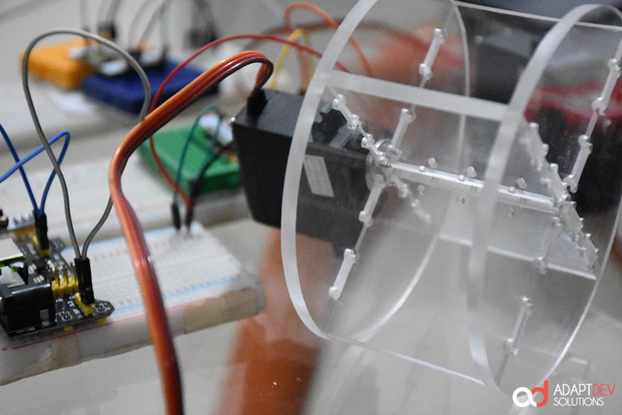
Fish Feeder

Slide 25
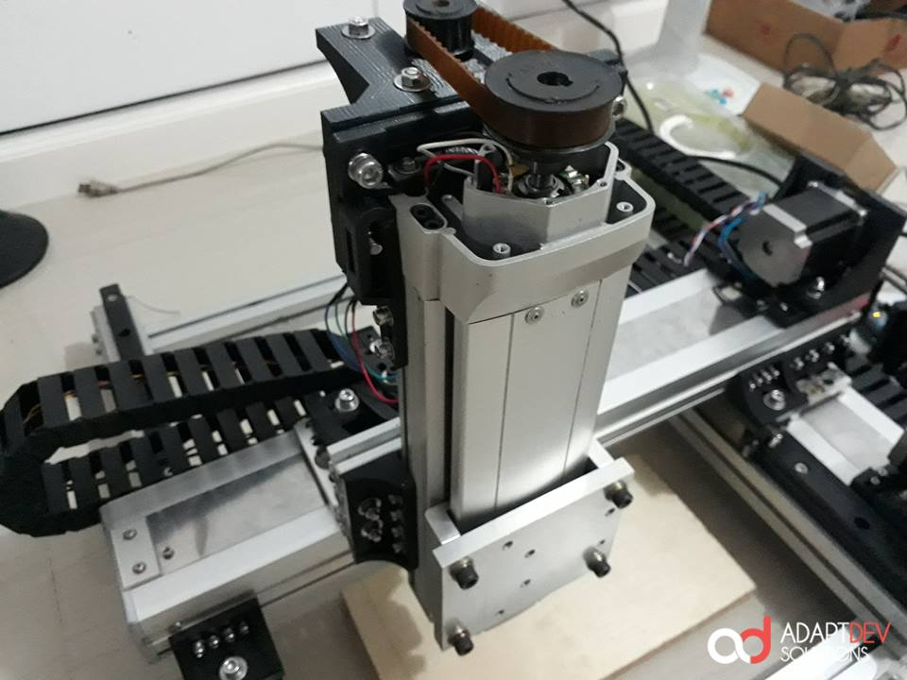
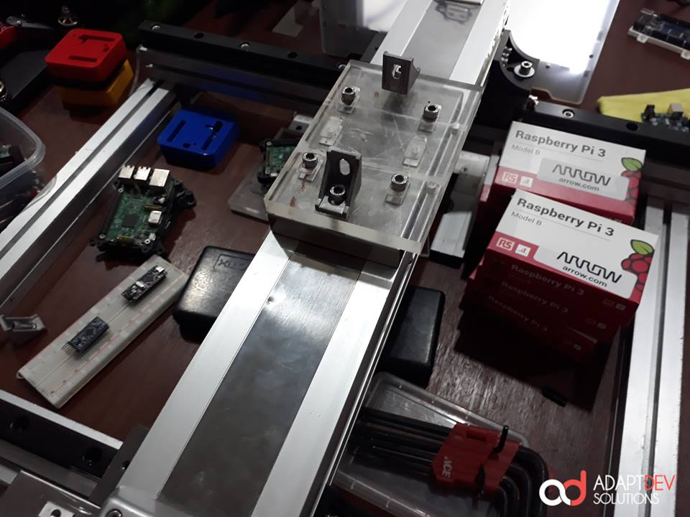
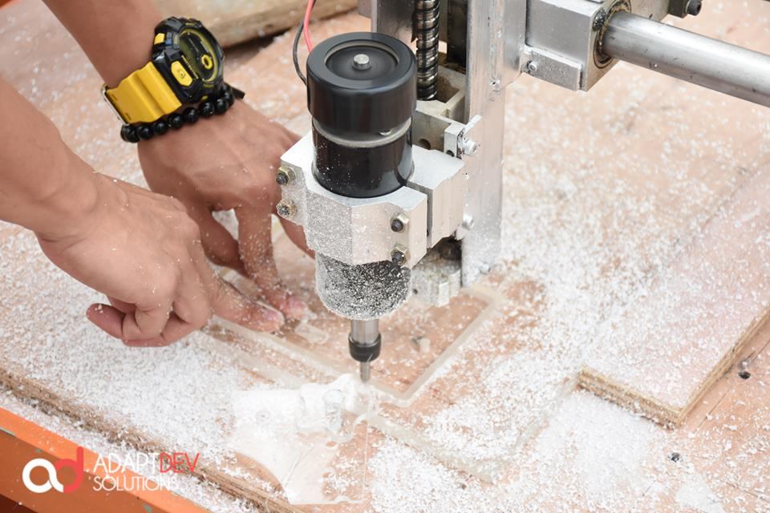
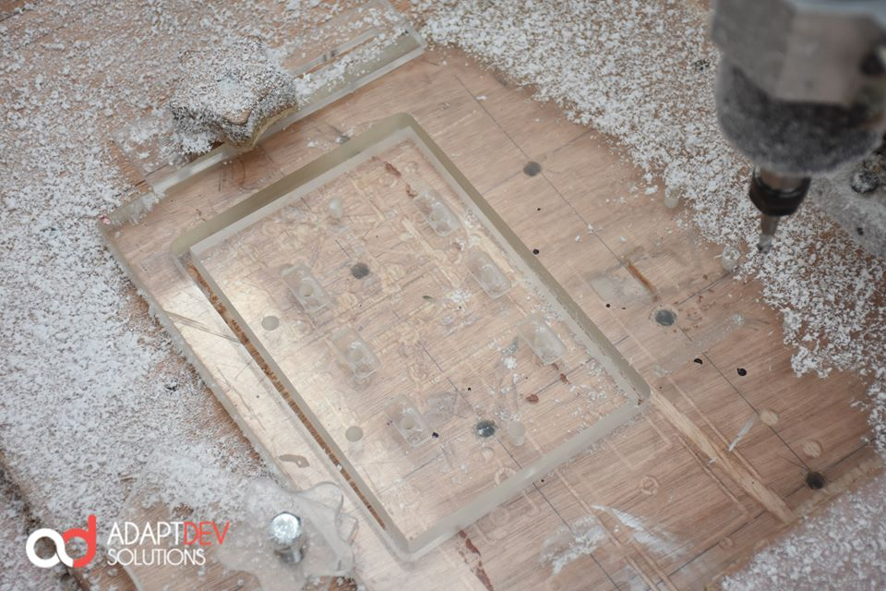
CNC

Slide 26
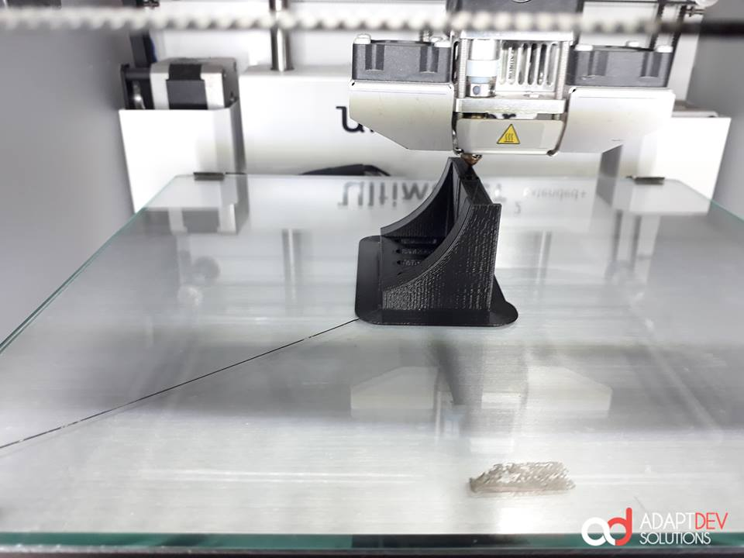
CNC

Slide 27
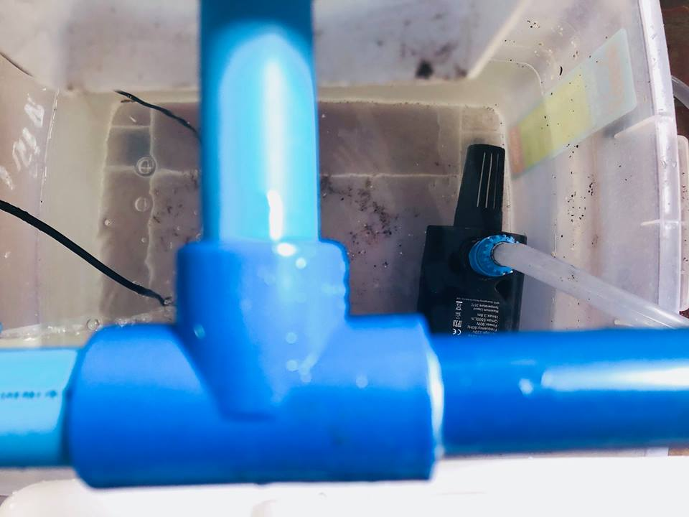
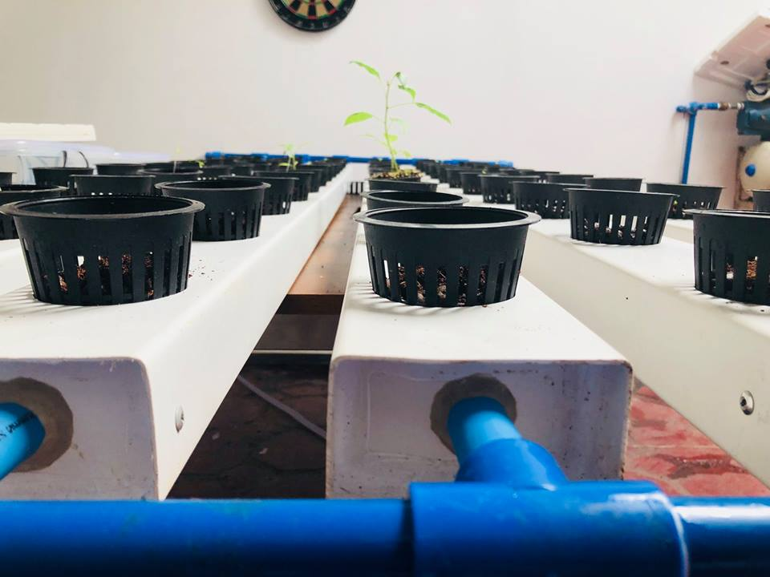
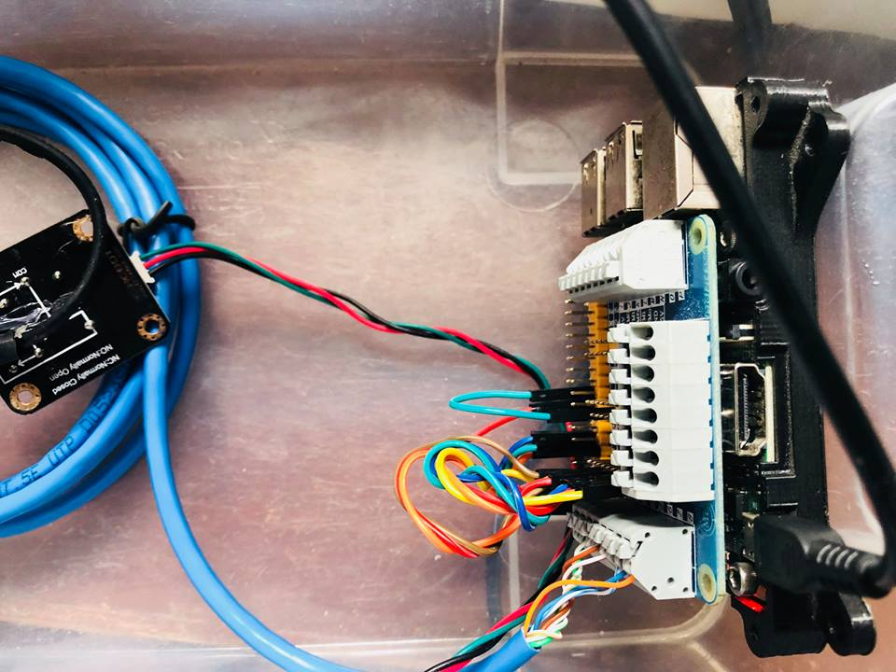
Hydroponics

Slide 28
THANK YOU !!

